Slide 1
Content Management Systems - CMS
A Path to the Future?
Notes:
Survey as background:
Survey objective was to collect information on technical state and future plans
50 8th AF-related websites – current “survivors”
We received 18 responses to initial contacts
5 survey responses
There are a number of different ways in which we have built our websites:
“Hand-coded”
Free website builders: GoDaddy, etc.
Inherited
Frameworks
Content Management Systems

Slide 2
The Challenges:
Technology Evolution/Obsolescence
Content Maintenance & Expansion
Search Engine Techniques
Continuity
Domain Registration
Hosting
Funding
Notes:
Which of these are significant to your website?
There are others:
Who will do the work?

Slide 3
What Do You Want For The Future?
Better?
Same?
Worse
POP QUIZ
Without action by us, our online content will get ______
Notes:
“Same” is an option, but cannot be achieved without action.

Slide 4
What’s Ahead?
The future is tomorrow now yesterday…
How can a CMS help?
Notes:
I have hit the Future threshold several times in the 17 years I have been responsible for websites.
Memory jogger: “The Mighty Eighth Message Board”, Gallery 1, 2, 3
Some others have fallen by the wayside and are no longer available!

Slide 5
What is a CMS?
A CMS is a set of software that resides on your hosting provider’s server.
It is configurable by the administrator (YOU) with
Templates – for “look and feel”
Plugins – for additional features
The content of your website is contained within the CMS
The CMS provides web pages to your site visitors
And - many hosting plans provide one or more CMS’s at no cost to you
More info: https://en.wikipedia.org/wiki/Web_content_management_system
Notes:
It is easy to say what it is
Deciding to use one, picking one, applying one – not so easy.

Slide 6
Areas Where a CMS Can Help
Technology Evolution/Obsolescence
CMS software is generally maintained by others
Updates can often be configured to occur automatically
Content Maintenance & Expansion
Content can be modified and expanded without requiring expert programming skills
Search Engine Techniques
CMS maintenance organizations maintain awareness of search engine changes and will implement changes to adapt to them
Some hacking protection
Notes:
Factors to think about:
Popularity of a CMS may indicate the likelihood of future support.
An active user community may be a resource for help and recommendations
Availability of plugins is a two-edged sword:
What you want will likely be available
How do you know if it is “safe”?
User reports
“Approved/controlled” distribution

Slide 7
CMS Examples
Wordpress
The Arrowhead Club
Joomla!
95th Bomb Group
Others
Drupal
Many others…
Notes:
CMSs support responsive designs thru templates
The Arrowhead Club: WP with Highlander template
95th BG: Joomla! with unknown responsive template
Also 100th BG uses Joomla!, but template is not responsive.
Anyone else?
CMS + Responsive Design via templates. Examples:
Wordpress: Reveal (“portfolio”)
Drupal: Adaptive, Omega, Zen
Respond: Energy
Joomla!: Eleven45

Slide 8
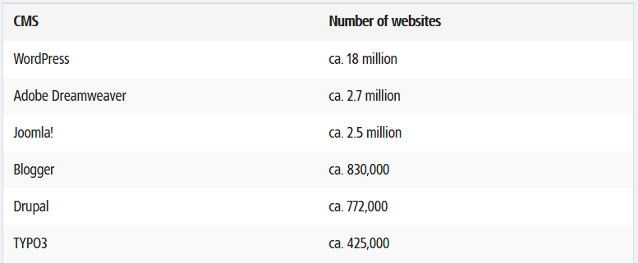
Additional CMS Information
Above information from this website:
https://www.1and1.com/digitalguide/hosting/cms/cms-comparison-a-review-of-the-five-best-platforms/
Notes:
Open Source or proprietary
Initial and recurring costs
Security
Ease of learning and use

Slide 9
Factors To Consider
What CMS is offered free by your Hosting Service?
Is future support “guaranteed”
What presentation features do you want?
Menus, columns, etc.
Effort required
To learn
To implement
CMS maintenance
Plugin maintenance
Notes:
Any technical requirements? Integration with other systems, such as a database?
Where does the development environment reside? The server, or your computer?
Automatic updates are available for some systems, but not all – and the manual update process may be easy or not.
Plugins come from many sources, and update cycle may be independent of the CMS update cycle.
A CMS update may break a plugin.

Slide 10
Areas Where A CMS Cannot Help
Continuity
Domain Registration
Hosting
Funding
Sorry about that…

Slide 11
Where Are You Headed?
Action now will preserve your online content.

Slide 12
Some Possibly Useful Stuff
W3C Markup Validation Service: https://validator.w3.org/
Some CMS Sites
Wordpress: https://wordpress.com/
Joomal!: https://www.joomla.org/
Drupal: https://www.drupal.org/
TYP03: https://typo3.org/
A Hosting Service That Provides Free Wordpress and Joomla!
Dreamhost: https://www.dreamhost.com/ (full disclosure: I use Dreamhost for my 384th Bomb Group Sites, but get nothing for the referral)
Copy of Presentation:
384th Bomb Group Website: SITEINFO → ADMIN → Utility Area
http://www.384thbombgroup.com/_content/_pages/admin_utility.php
Notes:
A related issue: using open source photo gallery software – 384th uses Piwigo, which is responsive.

